Slide 1
Java Beans
Basic Introduction

Slide 2
Introduction
allow complex systems to be build from software components
benefits of reusability and interoperability of a component-based approach
a component architecture is needed that allows programs to be assembled from software building blocks, perhaps provided by different vendors

Slide 3
How??
It must also be possible for a designer to
select a component
understand its capabilities
incorporate it into an application
When a new version of a component becomes available, it should be easy to incorporate this functionality into existing code

Slide 4
What is a Java Bean
A Java Bean is a software component that has been designed to be reusable in a variety of different environments

Slide 5
Properties of Java Beans
simple or complex
visible or invisible
works autonomously or cooperatively

Slide 6
Advantages of Java Beans
A Bean obtains all the benefits of Java’s “write-once, run-anywhere” paradigm
The properties, events, and methods of a Bean that are exposed to another application can be controlled
Auxiliary software can be provided to help configure a Bean
The state of a Bean can be saved in persistent storage and restored at a later time
Bean may register to receive events from other objects and can generate events that are sent to other objects.

Slide 7
Introspection
This is the process of analyzing a Bean to determine its capabilities.
2 ways which can indicate which of its properties, events, and methods should be exposed.
simple naming conventions
an additional class that extends the BeanInfo interface is provided that explicitly supplies this information

Slide 8
Design pattern for properties
A property is a subset of a Bean’s state
determines the behavior and appearance of that component
A property is set through a setter method
A property is obtained by a getter method.
2 types of properties:
simple
indexed

Slide 9
Simple properties
A simple property has a single value
N is the name of the property and T is its type
public T getN( ) //(read)
public void setN(T arg) //(write)

Slide 10
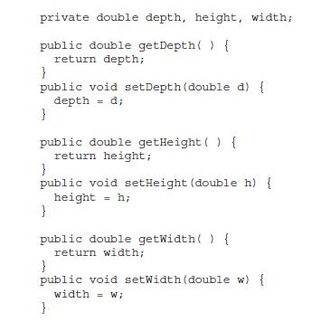

Slide 11
Indexed Properties
public T getN(int index);
public void setN(int index, T value);
public T[ ] getN( );
public void setN(T values[ ]);

Slide 12
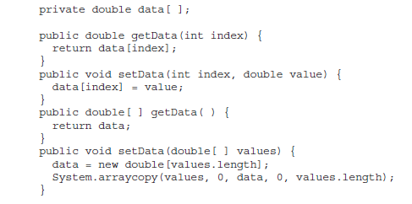

Slide 13
Design Patterns for Events
Beans can generate events and send them to other objects (Identified by the following)
public void addTListener(TListener eventListener) //multicast
public void addTListener(TListener eventListener) throws java.util.TooManyListenersException //unicast
public void removeTListener(TListener eventListener)

Slide 14
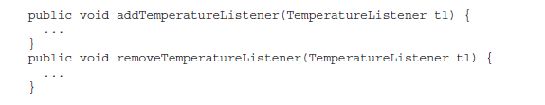

Slide 15
Methods and Design Patterns
Design patterns are not used for naming nonproperty methods
The introspection mechanism finds all of the public methods of a Bean
Protected and private methods are not presented

Slide 16
BeanInfo interface
design patterns implicitly determine what information is available to the user of a Bean
The BeanInfo interface enables you to explicitly control what information is available

Slide 17
BeanInfo interface methods
PropertyDescriptor[ ] getPropertyDescriptors( )
EventSetDescriptor[ ] getEventSetDescriptors( )
MethodDescriptor[ ] getMethodDescriptors( )
classes PropertyDescriptor, EventSetDescriptor, and MethodDescriptor are defined within the java.beans package
introspection is bypassed
Naming : bnameBeanInfo

Slide 18
SimpleBeanInfo class
provides default implementations of the BeanInfo interface
extend this class and override one or more of the methods to explicitly control what aspects of a Bean are exposed
if not overriden then design-pattern introspection will be used

